Slide 1
本征图像论文汇报（一）
汇报人：方阳

Slide 2
Content
1. SfSNet: Learning Shape, Reflectance and Illuminance of Faces `in the Wild‘（CVPR2018）
2. Single Image Intrinsic Decomposition without a Single Intrinsic Image（ECCV2018）
3. Joint Learning of Intrinsic Images and Semantic Segmentation （ECCV2018）
4. CGIntrinsics: Better Intrinsic Image Decomposition through Physically-Based Rendering（ECCV2018）

Slide 3
1. SfSNet: Learning Shape, Reflectance and Illuminance of Faces `in the Wild‘

Slide 4
Method Analysis
Previous works: learn from synthetic data, but generalize poorly in real world (different distribution)
Learning from real images(lack GT) only with reconstruction loss can cause the individual components to collapse on each other and produce trivial solutions, so learning from a mixture of labeled synthetic and unlabeled real world images, low frequency variations from synthetic data and the high frequency details in real data using shading cues through reconstruction loss.(SFS)

Slide 5
Contributions
SfS-supervision allows learning from a mixture of labeled synthetic and unlabeled real world images. Jointly learn normal, albedo and lighting from real images via reconstruction loss, outperforming approaches that only learn an individua component.
SfSNet, inspired by a physical lambertian rendering model. This uses a decomposition architecture with residual blocks to separate image features into normal and albedo, further used to estimate lighting.
remarkably better visual results compared to SOTA

Slide 6
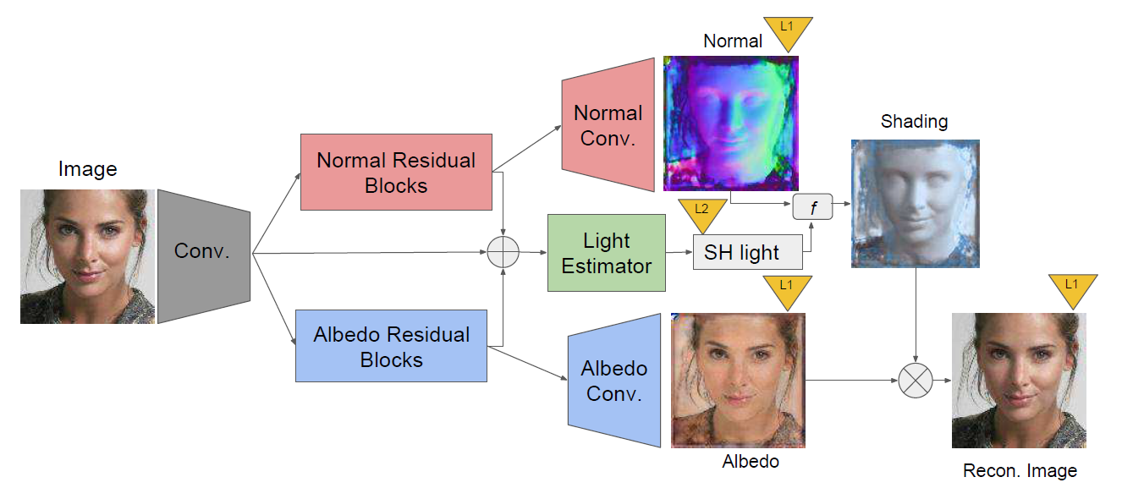
SFSNet Architecture

Slide 7
SFS-supervision Training
Step1: train network in synthetic data(3DMM)
Step2: apply network on real data to obtain pseudo-supervision
Step3: jointly train synthetic data and real data
Reconstruction loss plays a key role in learning from real data using shading cues while ‘pseudo-supervision’ prevents the collapse of individual components of the decomposition that produce trivial solutions.

Slide 8
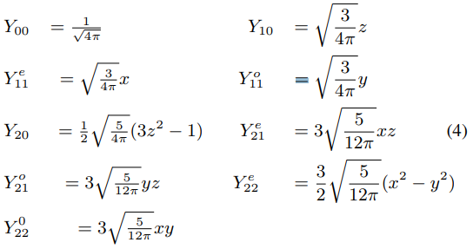



Let the normal be $n(p)$ = ${[x,y,z]}^{T}$at pixel $p$. Then 9 dimensional spherical harmonics basis $Y(p)$ at pixel $p$ is expressed as:
Then the intensity at pixel p is defined as :

Slide 9
Interesting Words
high frequency variations are passed from encoder to decoders through the skip connections.
Thus the networks do not have to necessarily reason about whether high frequency variations like wrinkles and beards come from normal or albedo.（the skip connection based network, the latent space is not informative as high frequency information is directly propagated from input to output bypassing the latent space. SfSNet learns an informative latent subspace for albedo and normal）
———————————————————————————————
Also in these networks the illumination is estimated only from the image features directly and is connected to normal and albedo through reconstruction loss only.
However since illumination can be estimated from image, normal and albedo by solving an over-constrained system of equations, it makes more sense to predict lighting from image, normal and albedo features.

Slide 10
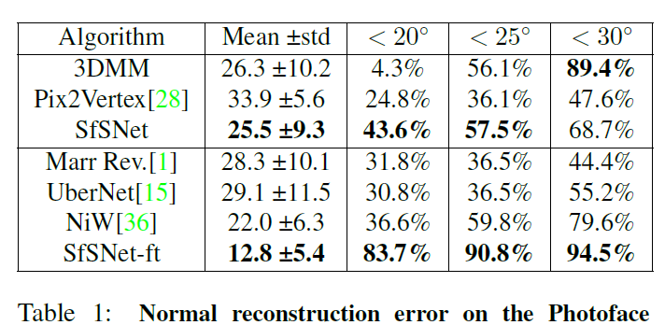
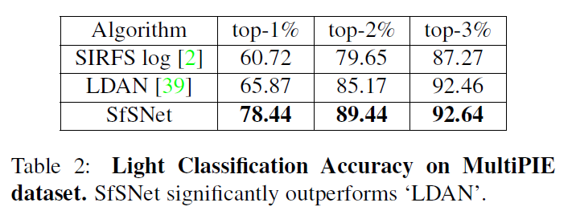
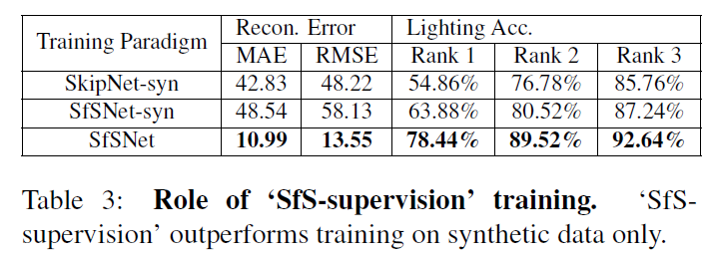
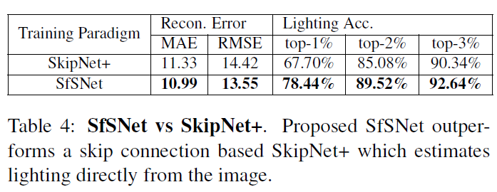
Experiment

Slide 11
2.Single Image Intrinsic Decomposition without a Single Intrinsic Image

Slide 12
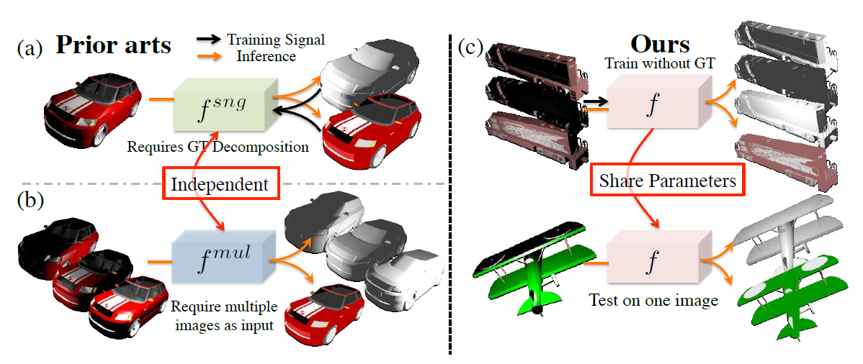
Method Analysis

Slide 13
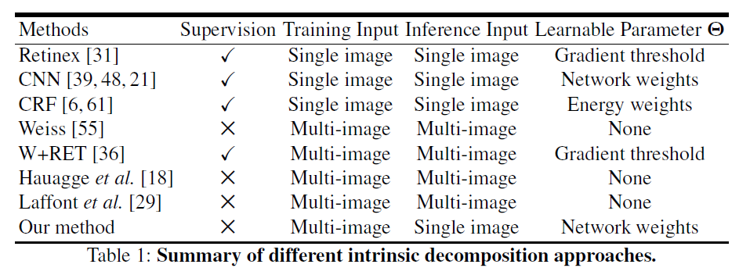
Contributions
the first attempt to bridge the gap between the two tasks（single imaged based and multi-image based）and learn an intrinsic network without any ground truth intrinsic image.
outperforms previous deep learning based single image intrinsic decomposition models using only 50% of ground truth data

Slide 14
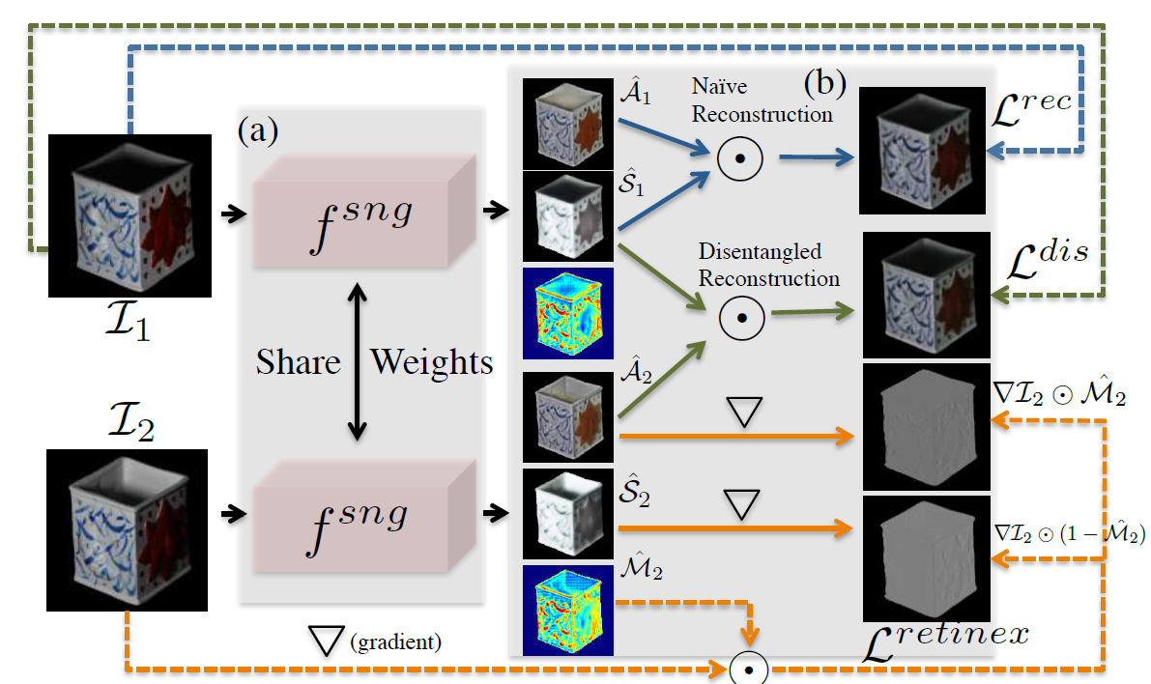
Network Architecture
Notes:
M2分配掩码输出由反照率变化引起的图像导数的概率

Slide 15
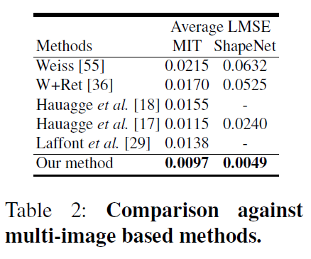
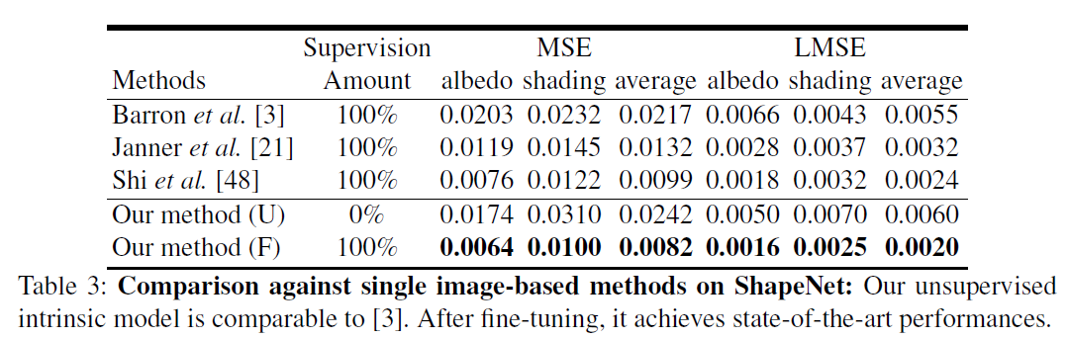
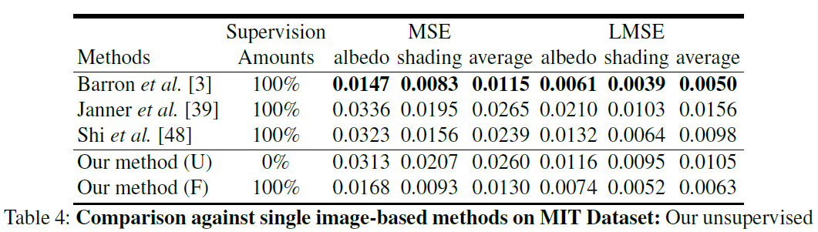
Experiment

Slide 16
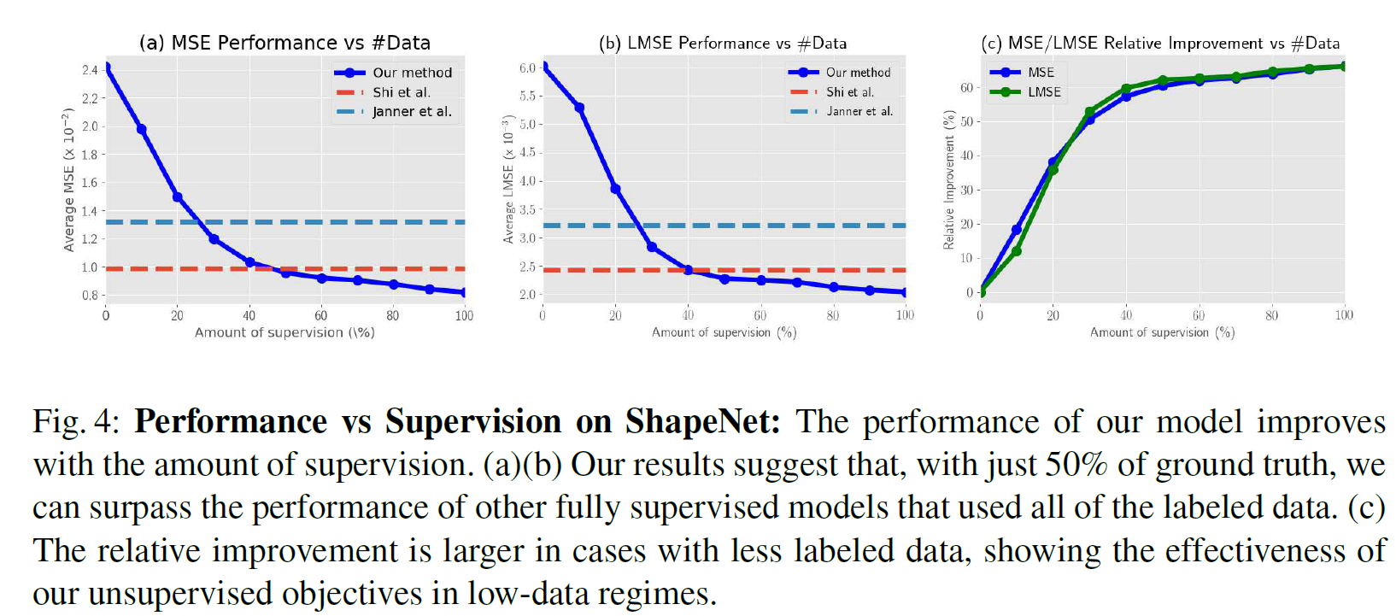
Result with amount of supervision

Slide 17
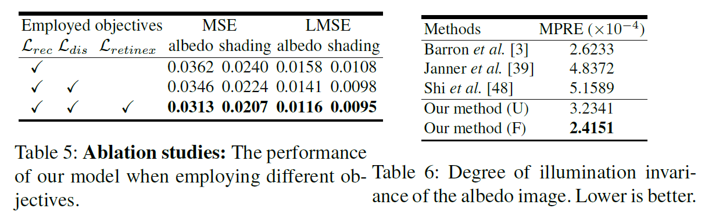
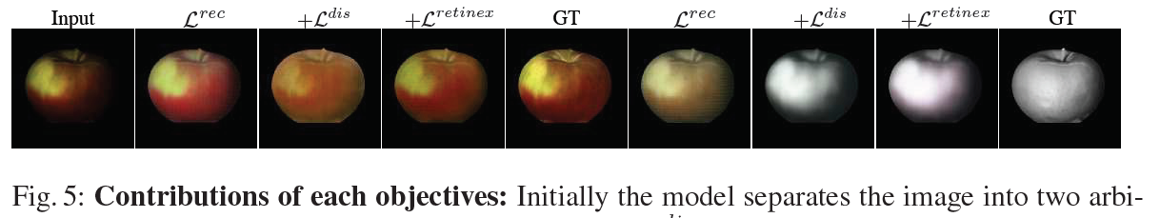
Ablation studies

Slide 18
3. Joint Learning of Intrinsic Images and Semantic Segmentation

Slide 19
Method Analysis
Variations in imaging conditions may negatively influence the segmentation process, using reflectance images for semantic segmentation task can be favorable, as they do not contain any illumination effect.
Each object label constrains the color distribution and is expected to reflect that property to class specific reflectance values. Therefore, distinct object labels provided by semantic segmentation can guide intrinsic image decomposition process by yielding object specific color distributions per label. Furthermore, semantic segmentation process can act as an object boundary guidance map for intrinsic image decomposition by enhancing cues that differentiate between reflectance and occlusion edges in a scene. In addition, homogeneous regions (i.e. in terms of color) within an object segment should have similar reflectance values.
Joint Learning of Intrinsic Images and Semantic Segmentation !

Slide 20
Contributions
a cascade CNN architecture for joint learning of intrinsic image decomposition and semantic segmentation (intrinsic-for-segmentation and segmentation-for-intrinsic)
analysis on the gains of addressing those two problems jointly
a very large-scale dataset of synthetic images of natural environments with scene level intrinsic image decomposition and semantic segmentation ground-truths.

Slide 21
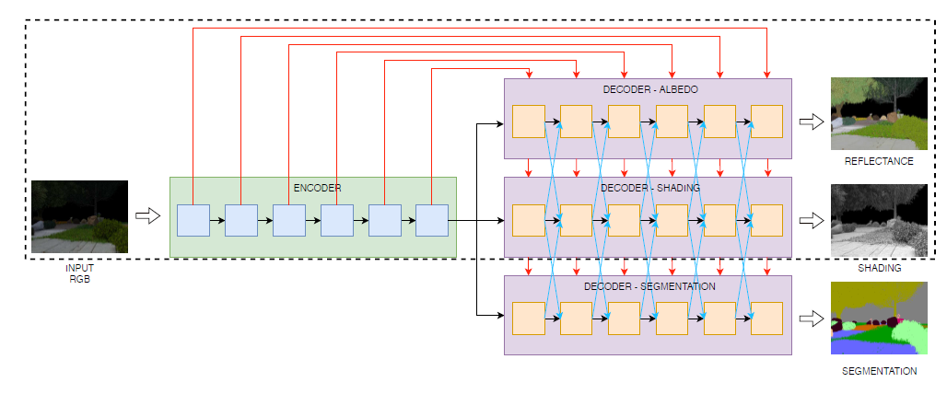
Network Architecture

Slide 22



Loss function

Slide 23
Experiment
Influence of Reflectance on Semantic Segmentation
Influence of Semantic Segmentation on Intrinsic Decomposition
Joint Learning of Semantic Segmentation and Intrinsic Decomposition
1. Comparison of the semantic segmentation accuracy.
2. Influence of joint learning on intrinsic property prediction
3. Influence of the weighting of the loss functions.

Slide 24
4. CGIntrinsics: Better Intrinsic Image Decomposition through Physically-Based Rendering

Slide 25
Method Analysis
The problem of existing synthetic datasets
1. limited to images of single objects (ShapeNet)
2. unrealistic illumination (CG Animation)
3. lack details of image, low SNR. (SUNCG)
The problem of real datasets (IIW and SAW)
1. sparse
2. difficult to collect
We need high-quality, high SNR, realistic, carefully-rendered synthetic dataset!

Slide 26
Contributions
CGINTRINSICS(CGI): the first large-scale scene-level intrinsic images dataset based on high-quality physically-based rendering
a new partially supervised learning method for training a CNN to directly predict reflectance and shading, by combining ground truth from CGI and sparse annotations from IIW/SAW
achieve state-of-the-art performance on IIW and SAW

Slide 27
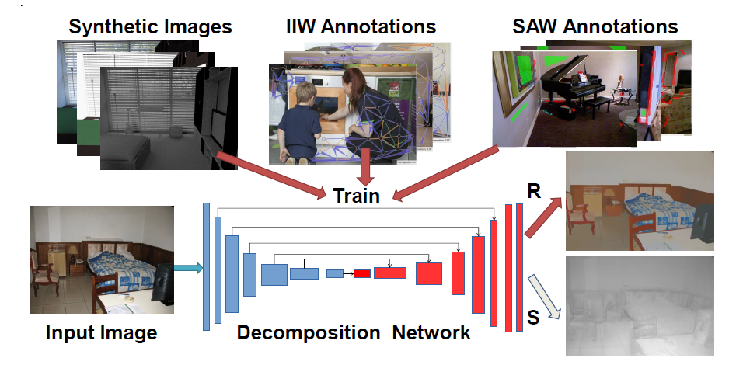
Network Architecture

Slide 28
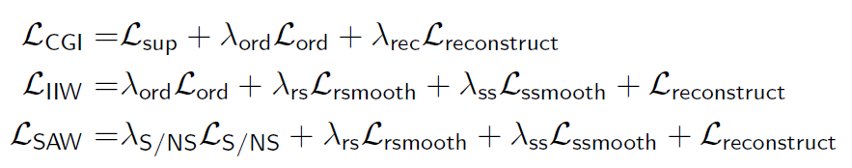
Loss Function overview

Slide 29

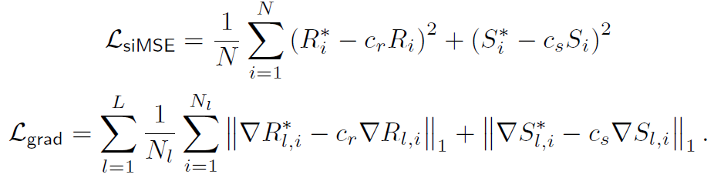
CGIntrinsics-supervised loss
Notes:
scale-invariant mean-squared-error and gradient domain multi-scale matching term(piecewise smooth with sharp discontinuities)

Slide 30

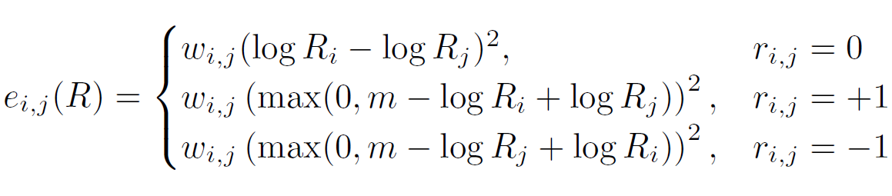
Ordinal reflectance loss(CGI and IIW)
Notes:
IIW provides sparse ordinal reflectance judgments between pairs of points

Slide 31
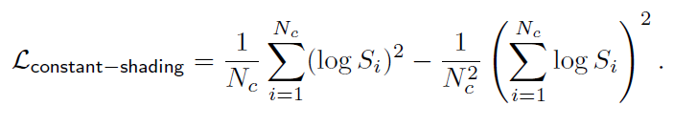
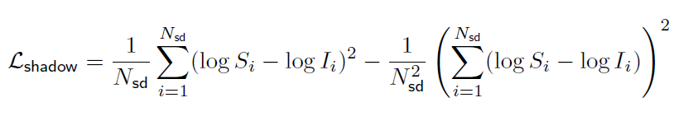
SAW shading loss
Three types: regions of constant shading, shadow boundaries, and depth/normal discontinuities.
Notes:
$L_{constant−shading}鼓励$预测阴影在该区域的方差为零，而对于$L_{shadow}$，作者发现大多数阴影边界标注位于反射率恒定的区域，这意味着对于一个小邻域内的所有对阴影像素，它们的log差应该近似等于图像强度的log差。这相当于鼓励$logs$i-logIi的方差在这个小区域是0

Slide 32
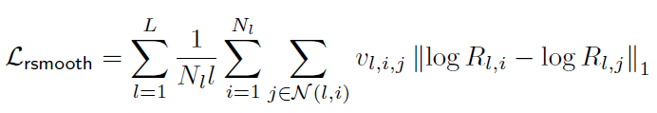
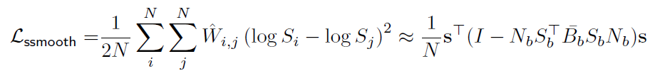
Smoothness losses
Notes:
对于反射率，我们使用多尺度L1平滑项来鼓励反射率预测是分段常数，对于光照图，一个双随机权矩阵下的L2loss，作者说这种loss能取得更好的结果。

Slide 33
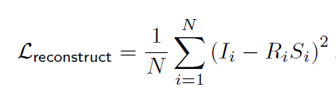
Reconstruction loss

Slide 34
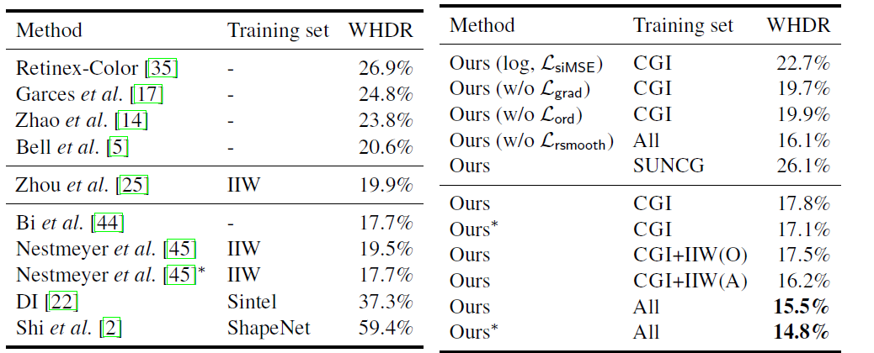
Experiment on IIW
WHDR: Weighted Human Disagreement Rate

Slide 35
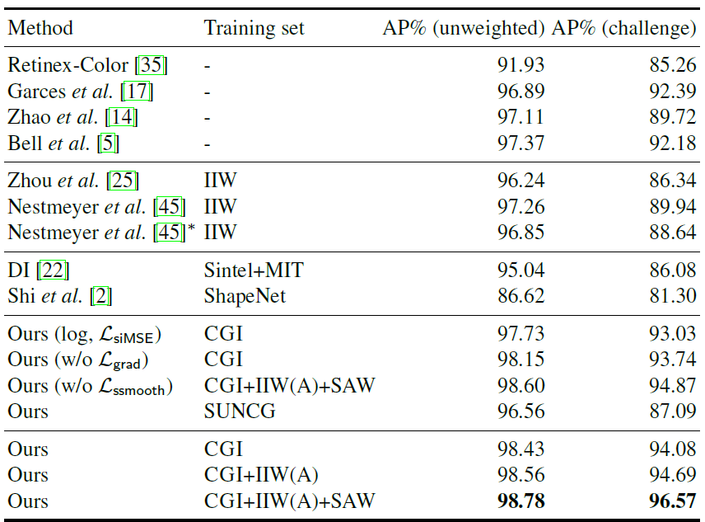
Experiment on SAW

